Slide 1
Text Book: Donald Hearn and M.Pauline baker,”Computer Graphics C Version”,Pearson Education
Reference Book: C Foley,Van Dam,Feiner and Hughes,Computer Graphics Principles & Practice.

Slide 2
Computer Graphics
INTRODUCTION
ADVANTAGES
AREAS OF APPLICATION

Slide 3
Introduction
Definition: Computer graphics involves display, manipulation data for proper visualization using computer.
Definition: Computer Graphics is the use of computer to define, store, manipulate, interrogate, and present pictorial output.
Generate 2D images of a 3D world represented in a computer.
Main tasks:
Modeling: creating and representing the geometry of objects in the 3D world
Rendering: generating 2D images of the objects
Animation: describing how objects change in time

Slide 4
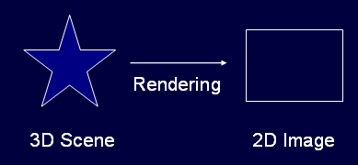
Rendering

Slide 5
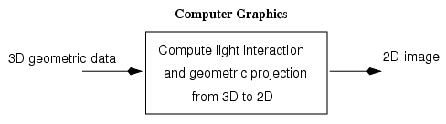

Slide 6
Typical graphical system consists of host computer with support of fast processor , large memory ,frame buffer and
Display devices(Monitors)
Input devices(keyboards, mouse , joysticks)
Output devices(printers, plotters, LCD panel)

Slide 7
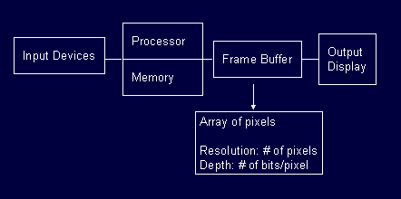
Graphic System

Slide 8
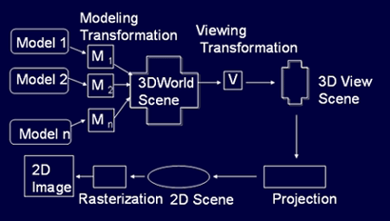
Graphic Rendering pipeline

Slide 9
Interactive Graphics System
Application
Model
Application
Program
Graphics
System
Display Unit
Input Unit

Slide 10
Designer of computer graphics system or software engineer puts his design in application model.
He will then writes the program to model the object he is planning to display.
This application will run on the computer graphics system and output will be displayed on the display devices and the required input can be obtained from the input devices.

Slide 11
Advantages
High quality graphics display provide best way to communicate with computer.
It is possible to produce animation.
Can be used to control animation such as speed, total scene in view etc.
Provides facility of update dynamic which can be used to change shape , color and other properties of object in view.
With the development in DSP it can provide audio feedback along with the video.

Slide 12
Application Areas
Computer Aided Design(CAD)
Presentation Graphics
Computer Art
Education and training
Visualization
Image processing
Entertainment
Movies Industry
Gaming Industry
Medical field
Graphical User Interface(GUI)

Slide 13
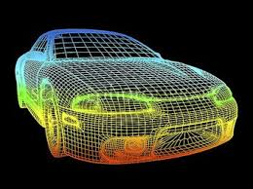
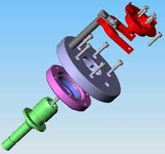
CAD
Major use of computer graphics is in design process, particularly for engineering and architectural systems.
This include design of buildings, automobiles, aircraft etc.

Slide 14
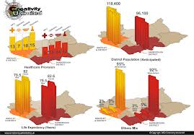
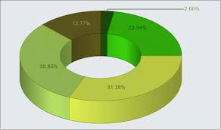
Presentation Graphics
Used to summarize the financial, mathematical, scientific and economic data.
Typical examples are bar charts, line graphs, pie charts etc.

Slide 15


Computer Art
Artist uses special purpose hardware and programs that provides facilities for designing object shapes and specifying object motion.
Examples pixel paint, super paint etc.

Slide 16
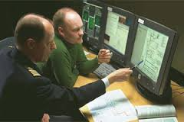
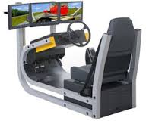
Education and training
Computer generated models of physical, financial and economic system are often used as educational aids.
Various kinds of simulators program can be used to provide the trainings. E.g. automobile driving simulator.

Slide 17
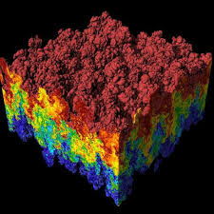
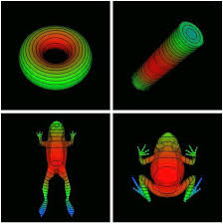
Visualization
Various techniques can be used to represent the large amount of data obtained from scientific , medical or business analysis.
These includes color coding, contour plots, graphs , charts etc.

Slide 18
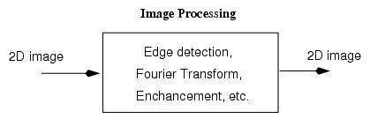
Image Processing
Computer graphics is used to create pictures.
Image processing applies techniques to modify or interpret the existing pictures.
It is used to:
Improve picture quality
Machine perception of visual information

Slide 19
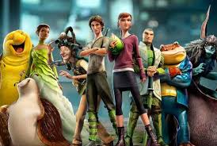
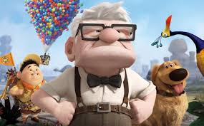
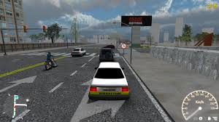
Entertainment
Computer graphics methods are now commonly used in making motion pictures, music videos , games and televisions shows.
Sometime graphics pictures are displayed by themselves and sometime combined with the actors and live scenes.

Slide 20
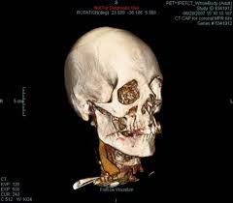
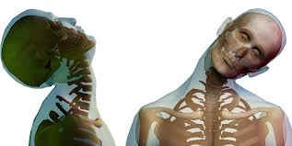
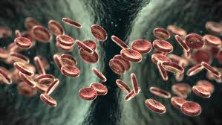
Medical Field
Computer graphics can also be used to represent the various internal parts and process of the human body.

Slide 21
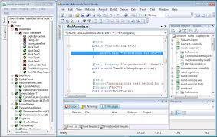
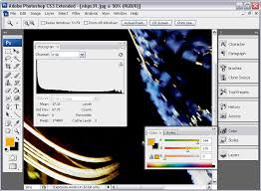
GUI
It is the interface of the software that communicates with the user with help of some input devices.
It contains number of windows , menus and icons for fast selection of processing options.

Slide 22
